Slide 1
Scaling Server-Sent Events (AKA Long Polling)
Stephen Ludin
Chief Architect, Akamai Technologies

Slide 2
What We Saw
09:51:23.051736 IP client.62471 > server.80: Flags [S], seq 233319732, win 65535
09:51:23.056777 IP server.80 > client.62471: Flags [S.], seq 227753171, ack 233319733, win 5792
09:51:23.056906 IP client.62471 > server.80: Flags [.], ack 1, win 32976
09:51:23.057034 IP client.62471 > server.80: Flags [P.], seq 1:156, ack 1, win 32976
09:51:23.061841 IP server.80 > client.62471: Flags [.], ack 156, win 215
And it just sat there…

Slide 3

Polling
How much longer now?
How much longer now?
How much longer now?
How much longer now?
How much longer now?
How much longer now?
How much longer now?
How much longer now?
How much longer now?
How much longer now?
How much longer now?
How much longer now?
How much longer now?
How much longer now?
How much longer now?
Dad, when are the fireworks starting?

Slide 4
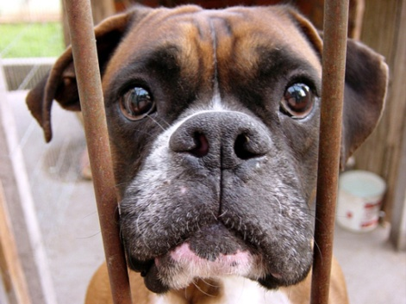

Long Polling

Slide 5
Long Polling – What is it?
A method for emulating ‘server push’ and providing real time notifications
  Browser uses XMLHttpRequest to connect to origin and waits
  When there is data to send, the origin responds
Variants and frameworks:
  Long Polling
  Server-Sent Events
  HTTP Streaming
  Bayeux
  BOSH
  Comet

Slide 6
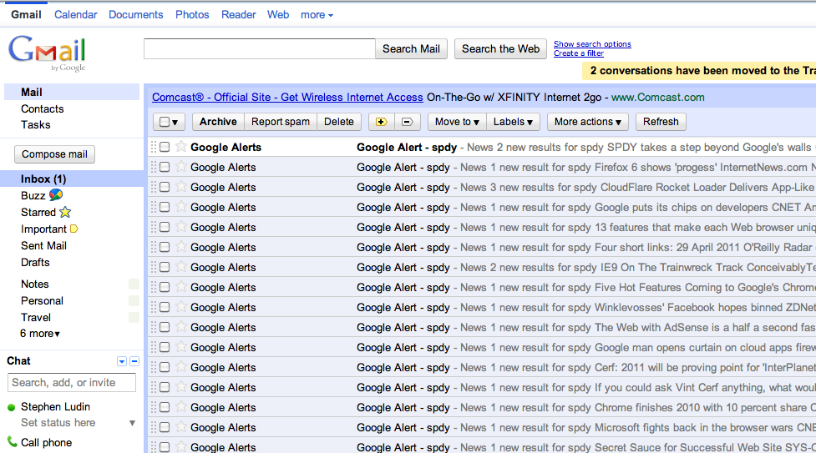
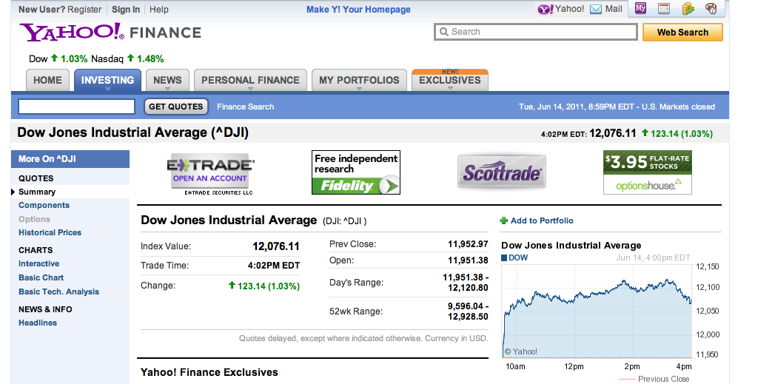
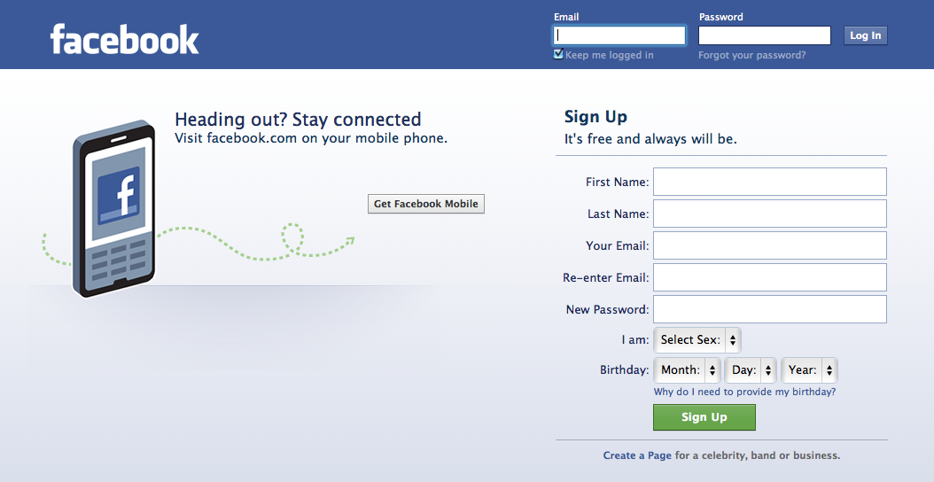
Usage is growing

Slide 7
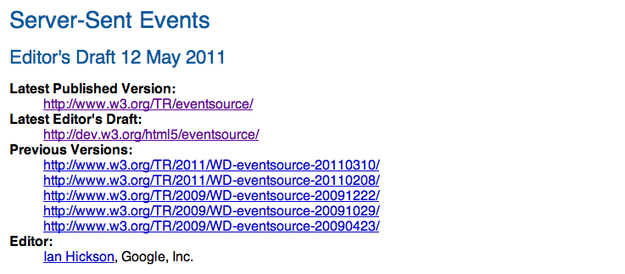
What’s Changing
Notes:
Talk about the implications of SSE
Mention XSLT
Ajax
Comet
Orbited
Real Time Web
XMPP over HTTP

Slide 8
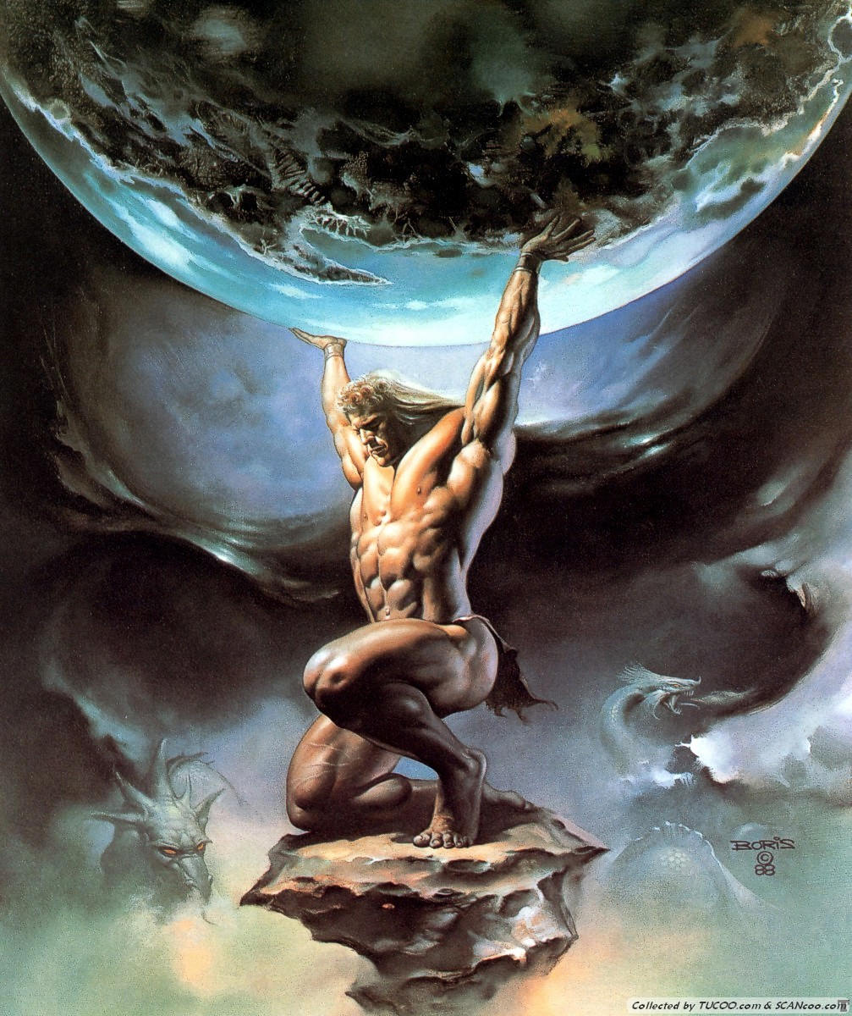
Requests For Help
Notes:
Holding connections open in memory or computationally expensive

Slide 9
The Challenges of Long-Polling for the Origin
Trading off high request rate (polling) for massive concurrent connections
Scaling at the Origin
  Not everyone has event-driven Web servers (Jetty, lighttpd, nginx)
  Still a lot of older architectures out there
What is really desired is a “Server Push” model
But despite all that, we still like long-polling
  Provides a “Real Time Web” without polling
  Makes modern HTTP applications possible
So: Is there a way to offload the connection load and provide server push?

Slide 10
In Short…
Everyone wants to use long polling, but scaling is a challenge.
Addressing this scale problem will result in better origin performance.

Slide 11



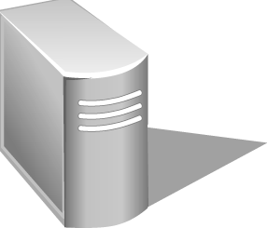
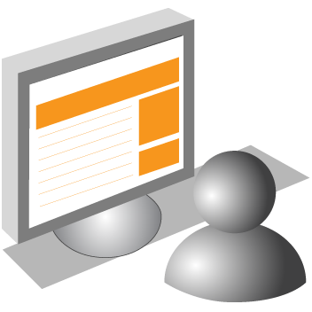
“Normal” HTTP Request Flow with a CDN
Notes:
Talk about what is a CDN
- Caching
- Acceleration
- Your new front door
- Security

Slide 12

Long Poll HTTP Request Flow with a CDN

Slide 13
How can a CDN help?
Offload Via Edge Caching or Computing?
Acceleration?
Application of business logic?
Security / Web Application Firewall?
Offload
Notes:
Stuck in the mindset that we cannot offload this traffic. It is ‘no-store’

Slide 14
Two Key Concepts
Half-Sync / Half-Async
  “Decouples synchronous I/O from asynchronous I/O in a system to simplify concurrent programming effort” ¹
Publish / Subscribe (Pub/Sub)
  The generic model behind most events
¹ Douglas C. Schmidt and Charles D. Cranor, 1996, “Half-Sync/Half-Async: An Architectural Pattern for Efficient
and Well-Structured Concurrent I/O”

Slide 15
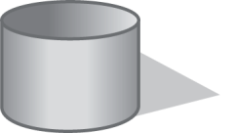
Requesting an Event (Subscribe)
“User A wants Event 1”
T
User | Event | Token
A | 1 | T1
B | 2 | T2
C | 1 | T3
User | Event | Token
A | 1 | T1
Notes:
Be clear about the token

Slide 16
Delivering the Event (Publish)
“I’ve Got Mail!”
Event 2 Fired for User B!
T
T
User | Event | Token
A | 1 | T1
B | 2 | T2
C | 1 | T3
User | Event | Token
A | 1 | T1
C | 1 | T3

Slide 17
Half Sync / Half-Async Benefits
Provides the ability to scale
Enables “true” Server Push
Retains “real time” notification
Makes load balancing at the origin easier
Makes infrastructure management at the origin easier

Slide 18
The Implementation
Token Construction
  Information needed to get back to the edge machine (IP)
  Customer specific code
  User information
  Subscription (Event) information
  Expiration

Slide 19
The Implementation
On the Client:
  Use HTML 5 Server-Sent Events
  Use old fashioned long-polling
  Essentially, do what you do today

Slide 20
The Implementation
On the Edge:
  Configure the surrogate to react appropriately

Slide 21
The Implementation
For example, on Akamai:
<match:uri.component value=“subscribe-event”>
<variable:extract from=“post” key=“id” name=“EVENT”/>
<variable:extract from=“cookie” key=“user” name=“USER”/>
<edgeservices:event.handle-subscription>
<token>
<key>ywewu238347i3u</key>
<nonce-source>PORT</nonce-source>
</token>
<user>$(USER)</user>
<event-id>$(EVENT)</event-id>
</edgeservices:event.handle-subscription>
</match:uri.component>

Slide 22
The Implementation
And go Forward with:
POST /subscribe-event HTTP/1.1
Host: mail.foo.com
X-Event-Id: 2
X-Event-User: B
X-Event-Token: of2948f394fornvo334o343o4oejo23jf2
X-Event-Signature: f1d2d2f924e986ac86fdf7b36c94bcdf32beec15
...

Slide 23
The Implementation
On The Origin - Subscription
  Receive the subscription request
  Respond with a “202” (eg.) in the positive
On The Origin – Event Firing
  When event fires, send the event data
    Sign token
    Application specific, recommend SSE
  Fire and forget, persist, or stream

Slide 24
The Implementation
POST /deliver-event HTTP/1.1
Host: event.foo.com
X-Event-Id: 2
X-Event-User: B
X-Event-Token: of2948f394fornvo334o343o4oejo23jf2
X-Event-Signature: e242ed3bffccdf271b7fbaf34ed72d089537b42f
Content-Length: 16
You’ve Got Mail!

Slide 25
Subscription Types
One Shot Event
  Force client reconnect (re-subscribe)

Slide 26
Subscription Types (cont)
Repeatable Event
  Origin → CDN: Multiple Requests
  CDN → Client: HTTP Streaming

Slide 27
Subscription Types (cont)
HTTP Streaming
  Similar to Multiple Events
  Potential for multiplexing

Slide 28
Security
Risk: Bogus Event Injection
SSL on all sides will help
  Origin to CDN MUST be authenticated
The token MUST be secure
  Necessitates a shared secret or more expensive asymmetrical operations
  Replay protection

Slide 29
Some Error Cases
Origin Rejects the subscription request
  An error is returned to the edge machine
  Edge machine delivers the error
Tokens are found to be invalid by some party
  Be paranoid
  Drop connections and force resubscription

Slide 30
Error Cases (cont)
Client drops and reconnects
  If detected by edge machine, unsubscribe event can be fired
  Origin should detect multiple subscriptions and resolve
  Optional: If client also has a token it can be used to reconnect to the original edge machine via redirect or tunneling
Edge machine ‘disappears’
  Devolves (hopefully) to a client drop and reconnect

Slide 31
Error Cases (cont)
Annoying routers dropping quiet connections
  Heartbeat events can help (Wait! Isn’t that polling?)
  Fortunately a well understood problem

Slide 32


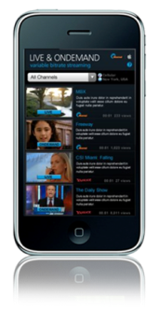
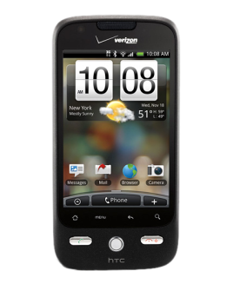
Mobile – Connectionless Push Friendly
Notes:
Preserve Battery life, etc.
iMessenger

Slide 33
What about WebSockets?
Not a good candidate (today)
  Bi-directional
  Opaque
Standard Acceleration techniques are ideal
Anticipating ‘standards’ in the future

Slide 34
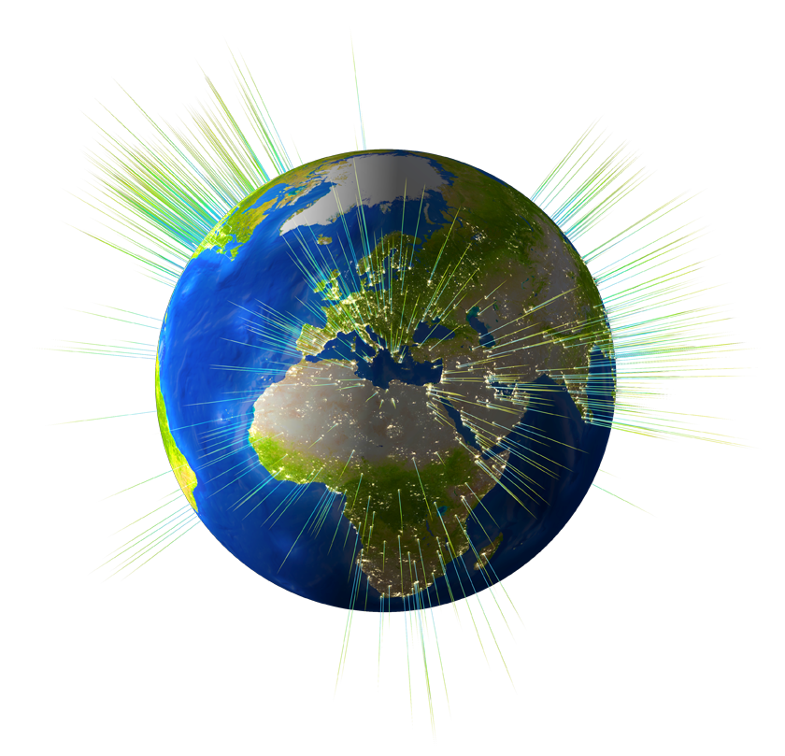
Use Cases
E-Mail
  Millions of users want to know when they get new mail. Now.

Slide 35
Use Cases
Social Networking
  What friends are online? What are they doing? I want to chat with them!

Slide 36
Use Cases
Stock Quotes
  BSC: 78.34
  BSC: 75.56
  BSC: 38.12
  BSC: 3.12
  BSC: Delisted

Slide 37
Use Cases
Cloud Printing
  Printer manufacturer sells 100 million Internet-enabled printers and wants to enable cloud printing in a scalable and efficient manner.

Slide 38
Summary
Server-Sent Events is a great thing
  Introduces connection scaling problems
  Formalizes long-polling methodologies
  Useful whenever a user is expected to wait a ‘long time’ for a reply
CDNs can help with the scaling problem
  Half-Sync / Half-Async
  Security Features
  Business Logic
  Acceleration
CDNs can provide a “server push” paradigm to the origin

Slide 39
Questions

